Slide 1
DNA sequencing

Slide 2
Genbank
https://www.ncbi.nlm.nih.gov/genbank/statistics/
First genome sequenced in 1995
(the bacteria H. influenzae with a
genome of 1,830,140 letters).

Slide 3
Basic BI tools
NCBI database
Uniprot, Prosite, Protparm, SNP
EXPASY
BLAST
ClustalW
Pdb or RCSB

Slide 4
DNA sequencing
PCR- Polymerase chain reaction
Electrophoresis
Sanger sequencing
Next-generation sequencing

Slide 5
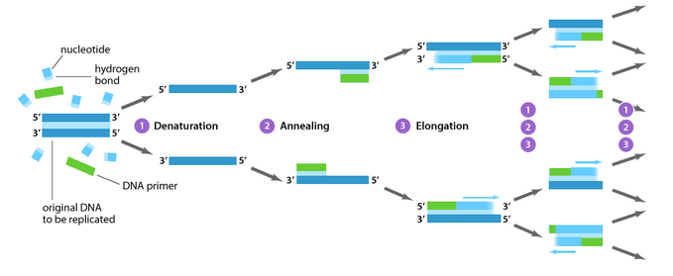
PCR-Polymerase Chain Reaction
https://www.youtube.com/watch?v=iQsu3Kz9NYo

Slide 6
PCR- reaction set up
Template DNA
dNTPs, i.e., dATP, dGTP, dCTP and dTTP
Taq polymerase that works at high temperature- made from a thermophilic organism

Slide 7
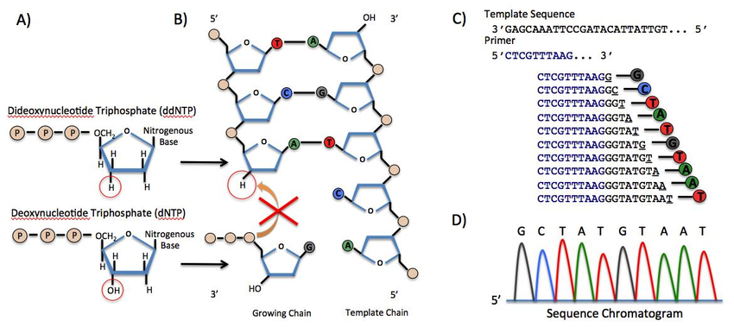
dNTPs vs ddNTPs

Slide 8
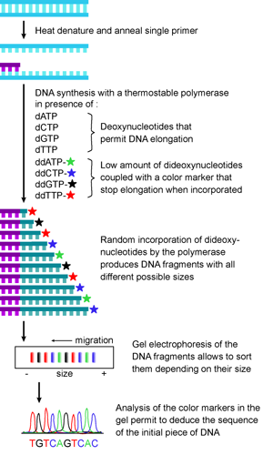
Incorporation of ddNTPs stops the PCR extension reaction

Slide 9
Stepwise sequence of events
AAGTCGATCGTGAGAGCTA
Let us concentrate on just one strand for understanding the events
ddATP
ddGTP
ddCTP
ddTTP
The concentration is chosen such that there is a random incorporation of the different dNTPS at different instances

Slide 10
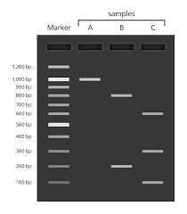
Principle of Electrophoresis
DNA is a charged molecule. It is a negatively charged molecule.
Therefore, it can migrate towards anode [positive electrode].
The shorter DNA fragments migrate faster through the pores of an agarose gel.

Slide 11
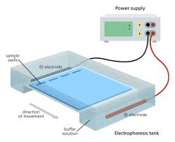
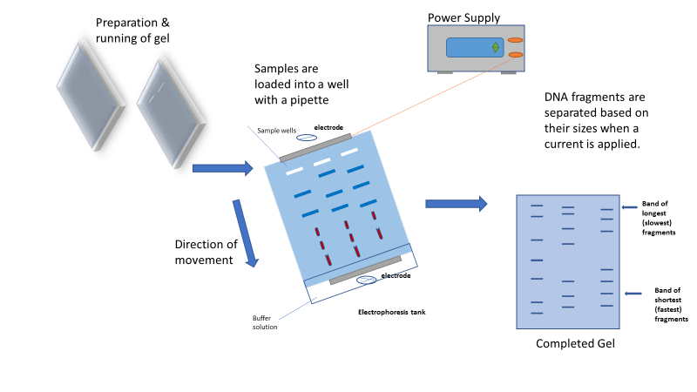
Electrophoresis

Slide 12
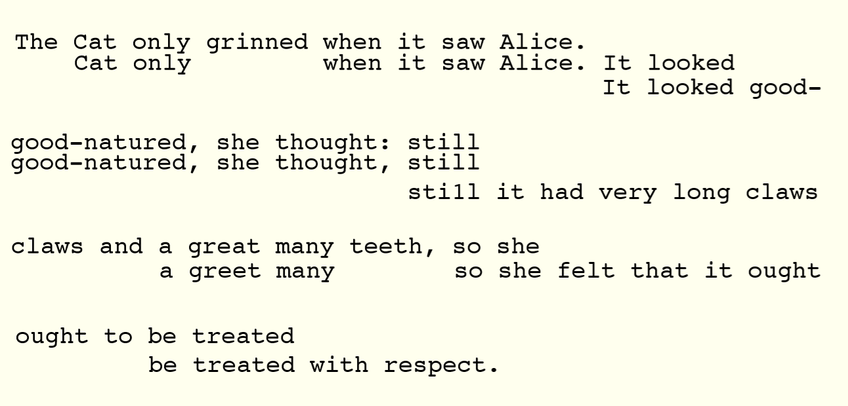

Slide 13
Sanger sequencing
It did not have these color coded dNTPs but had to use radiolabelled dNTPs.
In Sanger sequencing, the target DNA is copied many times, making fragments of different lengths. Fluorescent “chain terminator” nucleotides mark the ends of the fragments and allow the sequence to be determined.
In the Human Genome Project, Sanger sequencing was used to determine the sequences of many relatively small fragments of human DNA. (These fragments weren't necessarily 900900900 bp or less, but researchers were able to "walk" along each fragment using multiple rounds of Sanger sequencing.) The fragments were aligned based on overlapping portions to assemble the sequences of larger regions of DNA and, eventually, entire chromosomes.

Slide 14
Next generation sequencing
Next-generation sequencing techniques are new, large-scale approaches that increase the speed and reduce the cost of DNA sequencing.
https://www.ebi.ac.uk/training/online/course/ebi-next-generation-sequencing-practical-course/what-next-generation-dna-sequencing/454-seque

Slide 15
Sanger sequencing video
https://www.youtube.com/watch?v=FvHRio1yyhQ

Slide 16
Next generation sequencing
https://www.youtube.com/watch?v=shoje_9IYWc

Slide 17
Sanger sequencing- when there were fluorescent dyes
It did not have these color coded dNTPs but had to use radiolabelled dNTPs.
In Sanger sequencing, the target DNA is copied many times, making fragments of different lengths. Fluorescent “chain terminator” nucleotides mark the ends of the fragments and allow the sequence to be determined.
In the Human Genome Project, Sanger sequencing was used to determine the sequences of many relatively small fragments of human DNA. (These fragments weren't necessarily 900900900 bp or less, but researchers were able to "walk" along each fragment using multiple rounds of Sanger sequencing.) The fragments were aligned based on overlapping portions to assemble the sequences of larger regions of DNA and, eventually, entire chromosomes.

Slide 18
DNA sequencing
The process of reading the nucleotide bases in a DNA molecule
There are various sequencing technologies
Properties
Cost
Speed
Amount of data/number of sequences
Sequence length
Error rate

Slide 19
DNA sequencing
Sanger sequencing[since 1977]
High accuracy: 99.%
Long sequences:300-900 nucleotides
Expensive: $2400 per 1000,000 nucleotides
Few sequences: up to ~100
Next generation sequencing [around 2007]
Low accuracy 98-99.9%
Short sequences [100-400 nucleotides]
Inexpensive:$1 - $10 pernucleotides
Many sequences:500-3000000000 per ssequencer run

Slide 20
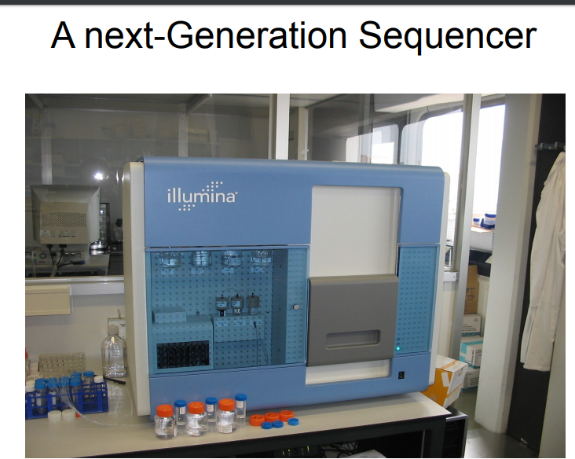

Slide 21
Next generation sequencing
Compare next-generation sequencing and upload your response online

Slide 22
Video pertaining to Sanger sequencing
https://www.youtube.com/watch?v=YeHtjO7vlyg
https://www.youtube.com/watch?v=FvHRio1yyhQ
https://www.youtube.com/watch?v=fCd6B5HRaZ8

Slide 23
Next generation sequencing
Next-generation sequencing techniques are new, large-scale approaches that increase the speed and reduce the cost of DNA sequencing.
https://www.ebi.ac.uk/training/online/course/ebi-next-generation-sequencing-practical-course/what-next-generation-dna-sequencing/454-seque

Slide 24
Huge amount of data now available, need algorithms to make sense of it.
Next up: sequence comparison using dynamic programming.

Slide 25
Example and activity
Incorporation of ddNTPs will stop the extension reaction.
AAGTCGATCGTGAGAGCTA
A
AA
AAGTCGA
AAGTCGATCGTGA
AAGTCGATCGTGAGA
AAGTCGATCGTGAGAGCTA

Slide 26
Activity
Incorporation of ddNTPs will stop the extension reaction.
AAGTCGATCGTGAGAGCTA
Now write down the length of each of the extended sequences above
A
AA
AAGTCGA
AAGTCGATCGTGA
AAGTCGATCGTGAGA
AAGTCGATCGTGAGAGCTA
AAG
AAGTCG
AAGTCGATCG
AAGTCGATCGTG
AAGTCGATCGTGAG
AAGTCGATCGTGAGAG
AAGTC
AAGTCGATC
AAGTCGATCGTGAGAGC
AAGT
AAGTCGAT
AAGTCGATCGT
AAGTCGATCGTGAGAGCT

Slide 27
Activity
Incorporation of ddNTPs will stop the extension reaction.
AAGTCGATCGTGAGAGCTA
Now write down the length of each of the extended sequences above
A
AA
AAGTCGA
AAGTCGATCGTGA
AAGTCGATCGTGAGA
AAGTCGATCGTGAGAGCTA
AAG
AAGTCG
AAGTCGATCG
AAGTCGATCGTG
AAGTCGATCGTGAG
AAGTCGATCGTGAGAG
AAGTC
AAGTCGATC
AAGTCGATCGTGAGAGC
AAGT
AAGTCGAT
AAGTCGATCGT
AAGTCGATCGTGAGAGCT

Slide 28
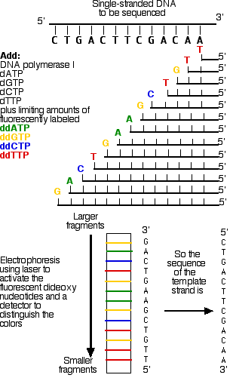

Slide 29
Databases of Biological Data
General Repositories
GenBank - USA
EMBL - Europe: http://www.ebi.ac.uk/embl/
Specialized by data type
NCBI Trace Archive - raw reads from sequencing machines
SwissProt - curated protein information: http://www.expasy.org
KEGG - metabolic pathways: http://www.genome.jp/kegg/
Gene Expression Omnibus (GEO) - gene expression
PDB - protein structures
Specialized by organism
ZFIN - zebrafish
SGD - yeast
WormBase - c. elegans
FlyBase - fruit fly

Slide 30
Primary Database
In bioinformatics, databases are often categorised as primary or secondary .
Primary databases are populated with
experimentally derived data such as nucleotide sequence, protein sequence or macromolecular structure.
Experimental results are submitted directly into the database by researchers, and the data are essentially archival in nature.
Once given a database accession number, the data in primary databases are never changed: they form part of the scientific record.

Slide 31
Secondary Database
Comprise data derived from the results of analysing primary data.
Secondary databases often draw upon information from numerous sources, including other databases (primary and secondary), controlled vocabularies and the scientific literature. They are highly curated, often using a complex combination of computational algorithms and manual analysis and interpretation to derive new knowledge from the public record of science.
Secondary databases have become the molecular biologist’s reference library over the past decade or so, providing a wealth of (often daunting) information on just about any gene or gene product that has been investigated by the research community. The potential for mining this information to make new discoveries is vast.

Slide 32
Genbank
https://www.ncbi.nlm.nih.gov/genbank/statistics/
First genome sequenced in 1995
(the bacteria H. influenzae with a
genome of 1,830,140 letters).

Slide 33
Genbank website

Slide 35
Gene annotation- worksheet
http://gander.wustl.edu/cgi-bin/hgTracks?db=Dere2&lastVirtModeType=default&lastVirtModeExtraState=&virtModeType=default&virtMode=0&nonVirtPosition=&position=contig7%3A32469-32552&hgsid=233875_3xKFBctndOgkOO8zPyiiOwPWCQ1V

Slide 36
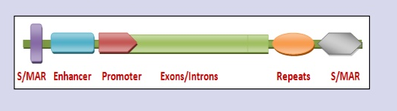
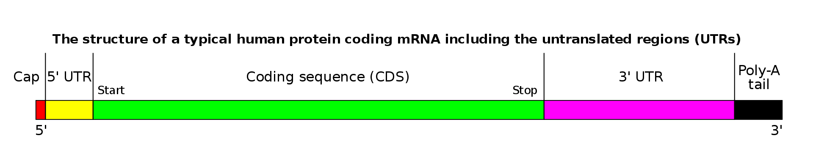
1. Signals
Localized motifs of various kinds
promoters
splice sites
start codons
stop codons
polyadenylation sites

Slide 37
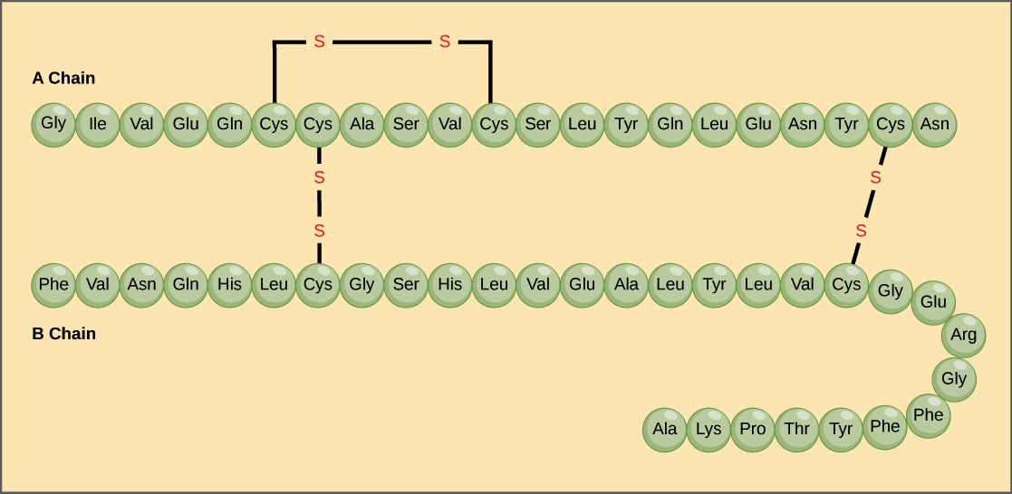
Protein Primary structure

Slide 38
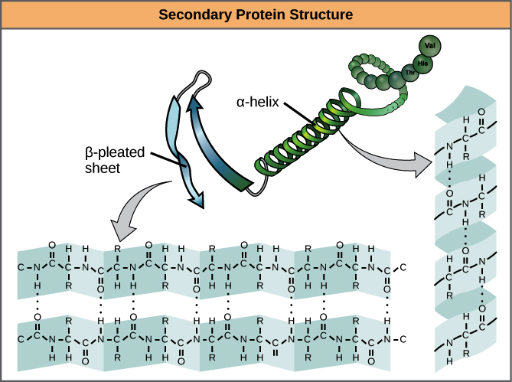
Protein secondary structure
α- Helix
β- sheets
Turns

Slide 39
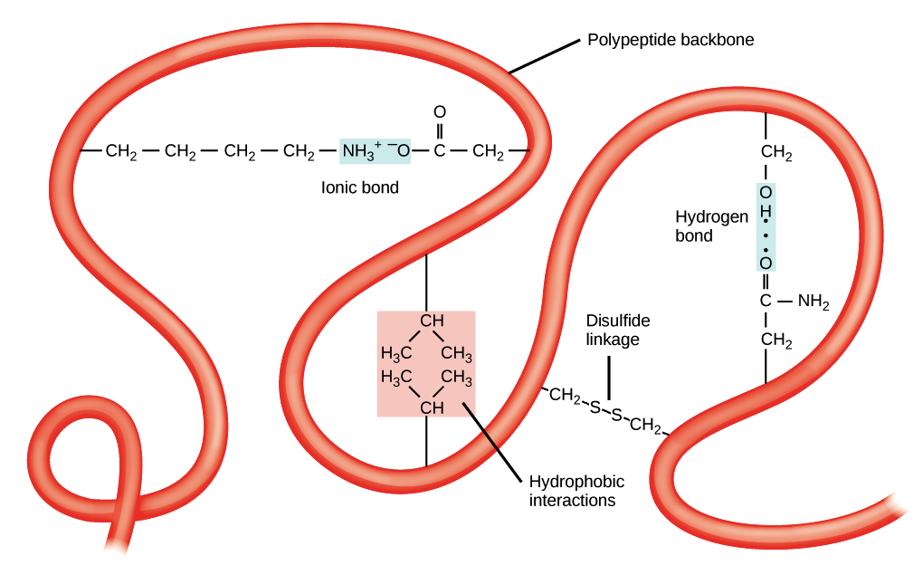
Tertiary structure of proteins

Slide 40
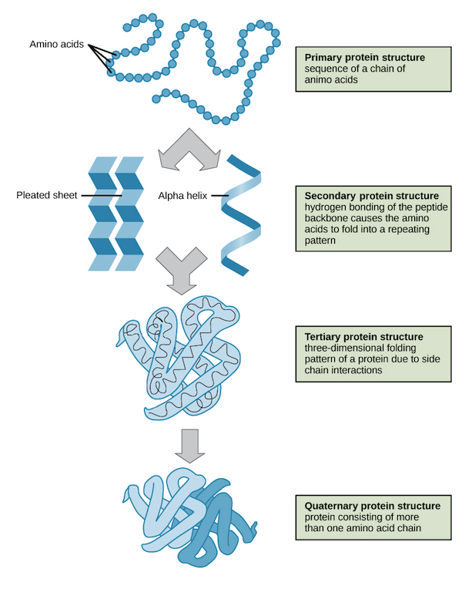
Quarternary structure
More than one subunits interact
Eg. Hemoglobin molecule
It is made up of 2α and 2β subunits

Slide 41
Protein secondary structure prediction
Now you know how the DNA code is decoded to protein sequence.
Online Expasy tools to translate
GOR- EXPASY
To find related family of proteins w.r.t domain functions
Pfam
SMART
3D- RCSB site

